Slide 1
Curriculum Night
2012-2013
Grade 5
Miss Livingston, Mrs. Wilds, and Mrs. Hagge

Slide 2

Classroom Rules
Be Respectful, Be Safe, Be Christian, Be Responsible
Contribute to the learning environment.
Follow classroom procedures.
Checkmark Chart
Good News Cards
Classroom Reward Systems
5 Demerits=visit with Dr. Williby
New Demerit Cards issued each QUARTER.

Slide 3

Discipline with Purpose
We will be incorporating the DWP skills into our everyday lives.
We will be completing activities and lessons using the 15 self-discipline skills.
Students will be recognized for using these skills throughout the year.

Slide 4
Language Arts
Reading: Our Reading Series is Houghton Mifflin McGraw Hill. Each unit consists of 5 short stories that are centered around the same theme. Each story within the units introduce and review various reading comprehension skills. These skills include: main idea and supporting details, inferencing, summarizing, problem and solution, cause and effect, character traits, plot, compare and contrast, and many more. When we are using the basal, students will be in guided reading groups. These are based on results of a “pretest” over skills and vocabulary. These groups can change! During Guided Reading each week, students will meet with the teacher to practice these skills on their level, work on centers that coincide with the theme, and independent work that reviews the skill in Reading, Spelling, Vocab, Writing, and/or Grammar. We will also assess the students’ fluency quarterly. Students will also practice these skills through completion of monthly book project and/or questions. Students will be assessed through tests, worksheets, discussions, and teacher observations.
Writing: Writing in 5th grade consists of using the 6 traits in their everyday writing. These six traits are: voice, word choice, sentence fluency, conventions, ideas, and organization. We will complete mini lessons/activities on each of these traits and apply that particular trait to bigger writing pieces. The types of writing pieces that we will work on are: letters, descriptive, persuasive, narrative, and expository. We will also share picture books that model this trait well so students can “hear” what that trait sound like. Students will also create monthly poems in their sketch pads. The goal of these is to introduce them to various poetry styles. Students will also complete a monthly poem. This will expose them to a variety of poetry and let the students write in a creative manner!
Novel Sets: Hatchet, Flush, Radio Fifth Grade, and many more!

Slide 5

Language Arts Continued
Grammar Workshop Grammar coincides with our Reading Series. Grammar skills will be applied to their writing and reading. Topics that will be covered in 5th grade are: sentences, fragments, types of sentences, pronouns, nouns, verbs, adverbs, adjectives, prepositions, interjections, conjunctions, and more! Students will be assessed through worksheets, book practice pages, tests, and projects. This series comes with a wonderful online resource that provides additional practice and games. It is organized by Units and Lessons.
Vocabulary Workshop: Students will learn a new unit of 12 Vocabulary Words every two weeks. Students will practice using these words in both their writing and conversation. Students will use the Vocabulary Workshop book. This book provides an excellent online resource where students can practice these words through various games. Their Vocabulary assignments and tests will be included in their spelling grade.

Slide 6
Math
Houghton Mifflin Mathematics
Students will learn about many different topics in 5th grade. Some of these are a review of previous years and some are new building off other concepts. The skills that we will learn and review in fifth grade are: place value of whole numbers and decimals, rounding, estimating, addition and subtractions of whole numbers and decimals, multiplication and division of whole numbers and decimals, number theory (factors, multiples, prime and composite numbers, greatest common factor, least common multiple, measurement both customary and metric, geometry, and fractions. Students will be assessed over these skills through in class instruction and observation, daily work, and quizzes and tests. If students receive below 75%-80% on these assignments, I will ask that they correct the missed problems. This will help me to know if they have grasped that particular concept. Students will also work on mastering math facts through Mad Minutes. We will do these about 2 times/week. In order to pass the operation, they need to get 45 out of 50. What Mad Minutes that aren’t passed in 5th grade will be continued in Middle School. We will also complete an Archdiocesan Assessment in the Spring. The students will need to see what Math Skills are used in planning a party on a budget. What a great way to apply what they know!
On the Math Section of my website, I will also include websites of games that will help them review for tests.
Students will have Math 4 days a week. Tuesday through Thursday for 45 minutes and an hour on Friday. Friday’s longer class helps us review what we have learned through games and assessments.
In April, students will take an Algebra Assessment. The results of these help us place the students in Middle School Math.

Slide 7
Interactive Science
Students will learn about many different topics in 5th grade. The concepts and skills that we will learn and review in science are:
the nature of science
technology and design
plants and animals
ecosystems
recycling and pollution
systems of the human body
the water cycle
energy sources
solar system
matter and energy
force and motion
Students will be assessed over these skills through in class instruction and observation, daily work, projects and tests. If students receive below 75%-80% on these assignments, they will have the opportunity to re-do the assignment.
On the Science section of my website, I will also include some notes and main points of the lessons we go over in class for extra help outside the classroom. Students will have Science 4 days a week. Tuesday through Friday for 45 minutes.

Slide 8


Religion
Harcourt Religion Series – Call to Faith
In fifth grade, students will discuss many topics that encompass our
Catholic Faith. Topics that we will cover this year include: Faith, Circle of
Grace, Rosary, Saints, Church Calendar, Parts of the Mass, and Sacraments.
In the Spring, we will begin Benziger Family Life. We will go in more detail
about this at a Parent Meeting closer to the beginning of this Unit.
In the Spring, students will also complete an Archdiocesan Game Show Assessment. The goal of this assessment is to review the basic facts, signs, symbols, scripture references, and meaning of these sacraments. This will be a group project and most of the work will be completed at school.

Slide 9
Social Studies
Harcourt Horizons U.S. History (2010 copyright)
We will begin the year reviewing basic geography and map skills. We will also review identifying different kinds of maps (political, physical, and elevation). We will then move into the study of Native Americans, Early Explorers, Thirteen Colonies, and the American Revolution.
Throughout the year we will work on mastering our states and capitals (spelling and placing them on a map). We will also work with Ms. Fosco to create a web site for The Great State Race. This will be a year-long project. At the end of the year, each student will use information that we gathered from our website to create a final project about a specific state. These projects will be presented at the end of the 4th Quarter.
I use my website a lot! I always have extra practice links and games that kids can use at home. These are all located on the Social Studies section of my website.

Slide 10
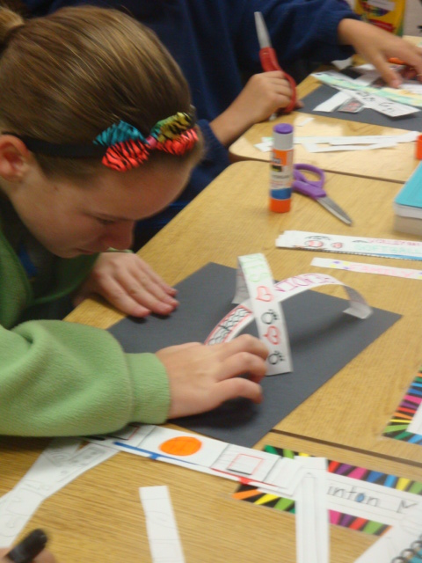
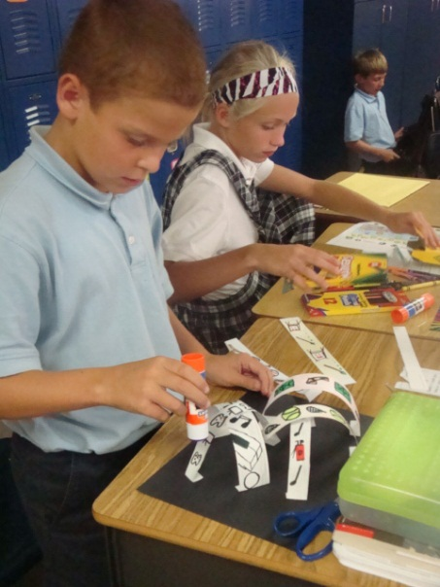
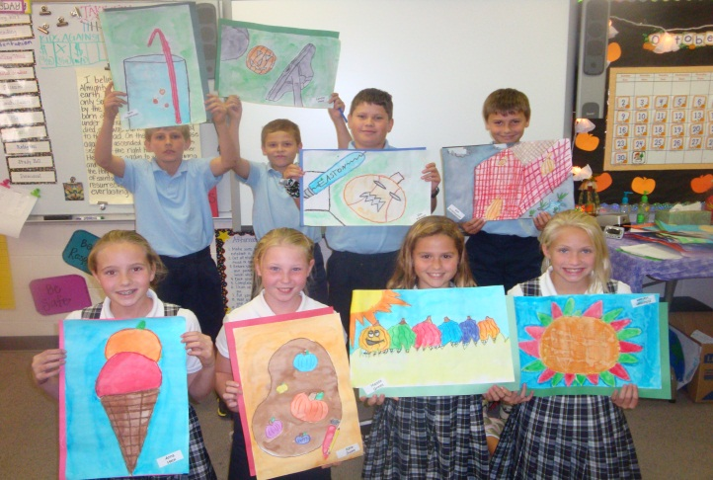
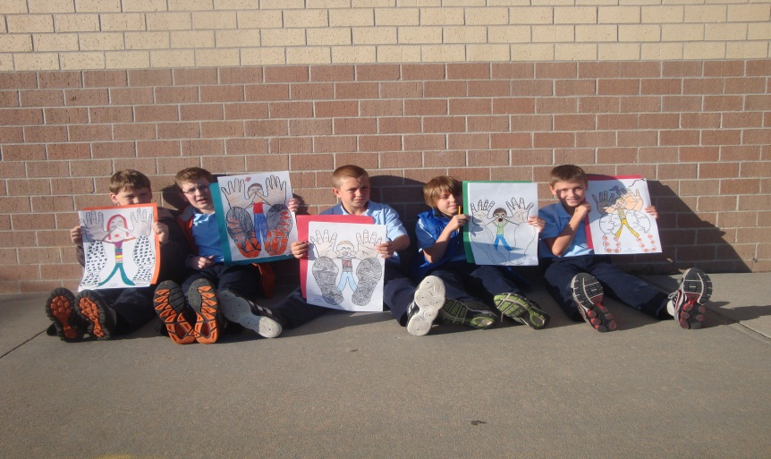
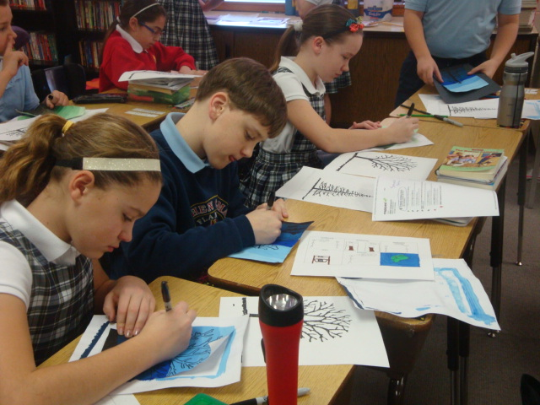
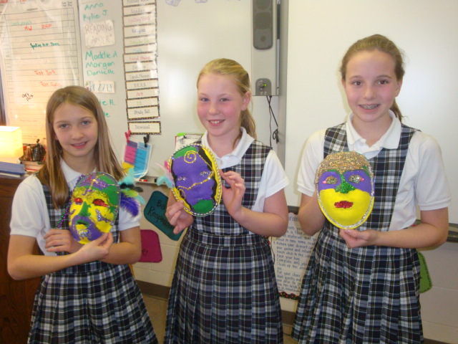
Art
We will be learning about a variety of art vocabulary (tones, color wheel, techniques, and masterpiece artists throughout the year.

Slide 11

Fantastic Fifth Grade
- BITS AND PIECES
We look forward to having a very productive and positive year. Please refer to the 5th Grade Handbook in regards to late assignments and missing work. There will be various long-term projects. The content area assessment is one goal, but another goal of these is to help the students with long-term planning. Please help your child plan out their work. If you need assistance in this manner, please don’t hesitate to ask.
We are available through e-mails, notes, or phone. Feel free to contact us for ANYTHING!!! We update the newsletter sections of our website at the end of each week. The content includes what will be studied the following week, and upcoming tests, quizzes, and projects. Please check this on a regular basis to help with planning. We also suggest having your students get familiar with these websites as well. Many extra hints and resources will be placed on different sections to help out in various classes.
EDLINE – Edline is our online grading database. Please check this on a regular basis. Also, please refer to the Edline section of the 5th Grade Handbook for more information. Teachers update grades about every two weeks. We suggest setting the account to receive email notification when new grades are posted.

Slide 12
Teacher Contact Information
Miss Livingston(5A) Room 219
  e.livingston@stephen.org
  http://misslivingston.yolasite.com
  Mrs. Wilds (5B) Room 218
  j.wilds@stephen.org
  http://mrswilds.synthasite.com/
  Mrs. Hagge(5C) Room 220
  a.hagge@stephen.org
  http://mrshagge.yolasite.com
School Website: www.stephen.org
School Phone: (402) 896-0754

